Slide 1
It’s All About Giving Commands

Slide 2
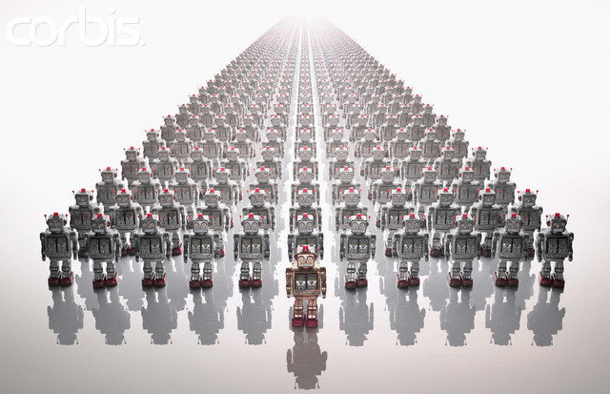

Slide 3
Like A King

Slide 4

Forward

Slide 5
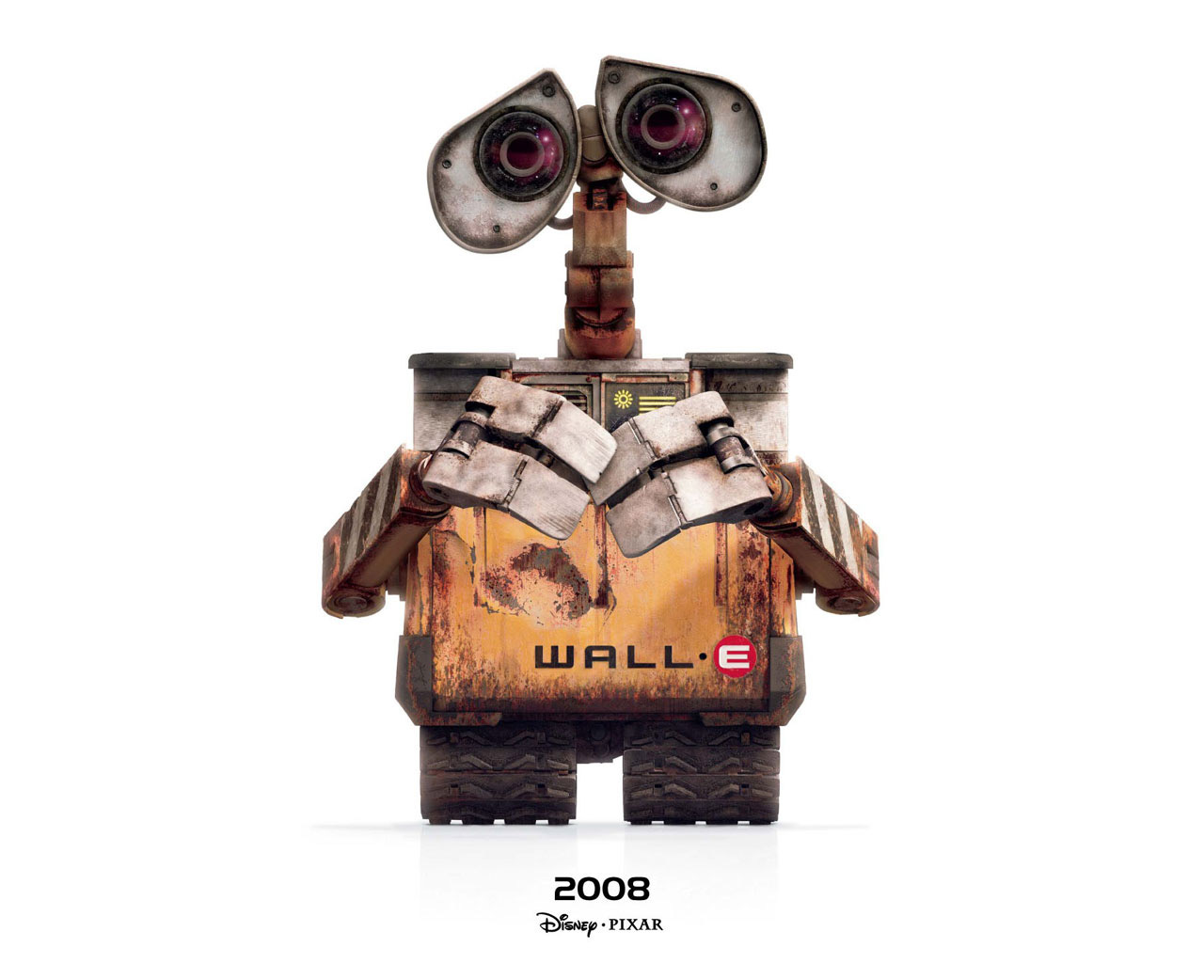
?
?

Slide 6
Traceback (most recent call last):
File "/Users/jon/test.py", line 3, in <module>
NameError: name 'Forward' is not defined
?
?

Slide 7
A.K.A

Slide 8
Yo dude, I don’t know what “Forward” means
?
?

Slide 9
FORWARD!

Slide 10
?
?
?
?

Slide 11


Slide 12

Let’s Try Again
You have to say at what speed

Slide 13
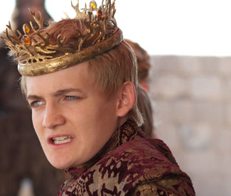

Slide 14
Forward
At speed .5

Slide 15
?
?
?
?

Slide 17
Let’s Try Again
You have to talk in a computer language, look at the Not A Cheatsheet

Slide 19
Forward(.5)

Slide 20
?
?
?
?

Slide 21
Yo dude, I don’t know what “Forward” means
?
?

Slide 23
Let’s Try Again
Capitalization matters, look at the Not A Cheatsheet Carefully!

Slide 25
forward(.5)

Slide 26
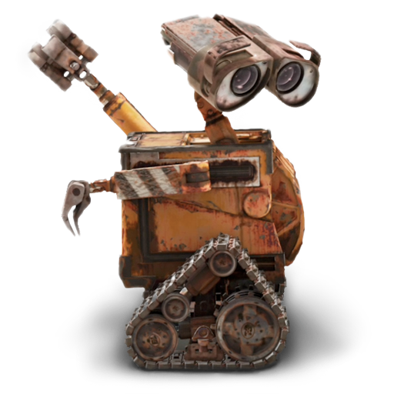

Slide 28
Let’s Try Again
If you don’t want your robot to go forever, you have to tell it how long it should go!

Slide 30
forward(1, 2)

Slide 32


Slide 33
Don’t Be Like This

Slide 35


Why So Frustrated?

Slide 36


Slide 38

Help Me Get My PS4

Slide 39
Twitch Plays Pokemon

Slide 40
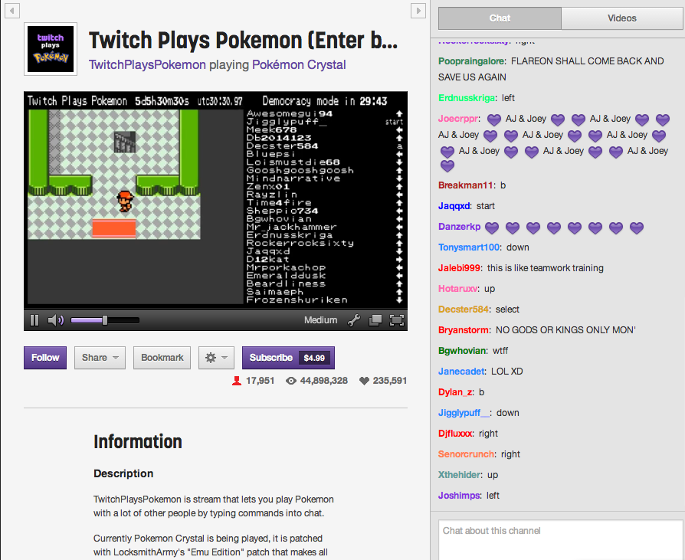

Slide 41
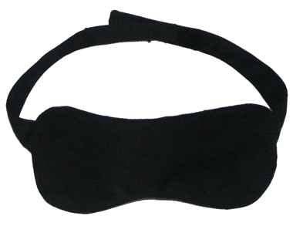
BLINDFOLDED

Slide 42
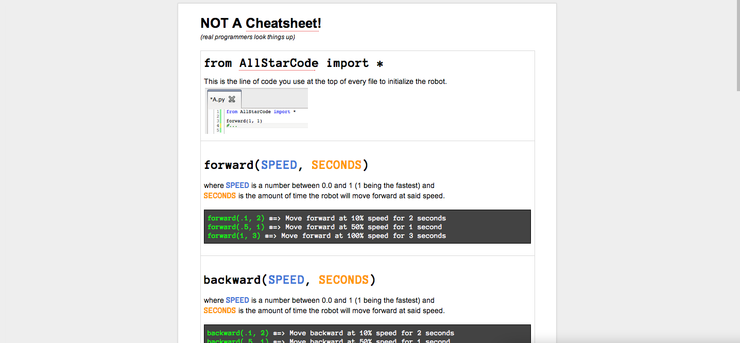
This is my instruction manual

Slide 43
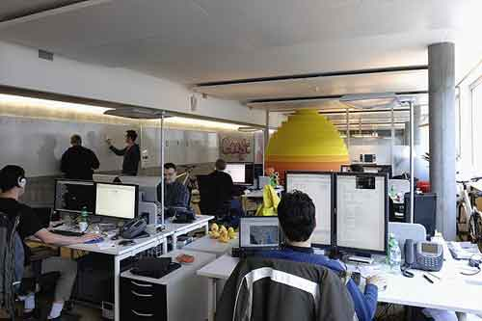
Real Programmers Read & Google How To Do Things

Slide 44


Slide 45


Slide 46
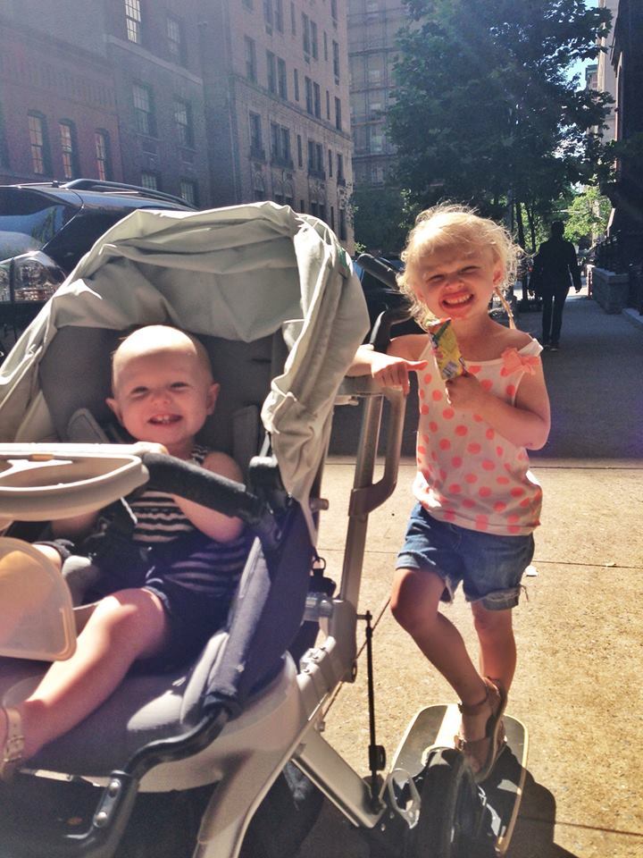

Slide 47
You Will Need New Commands To Guide Me

Slide 48
So a minute to checkout the sheet with your partner.

Slide 49
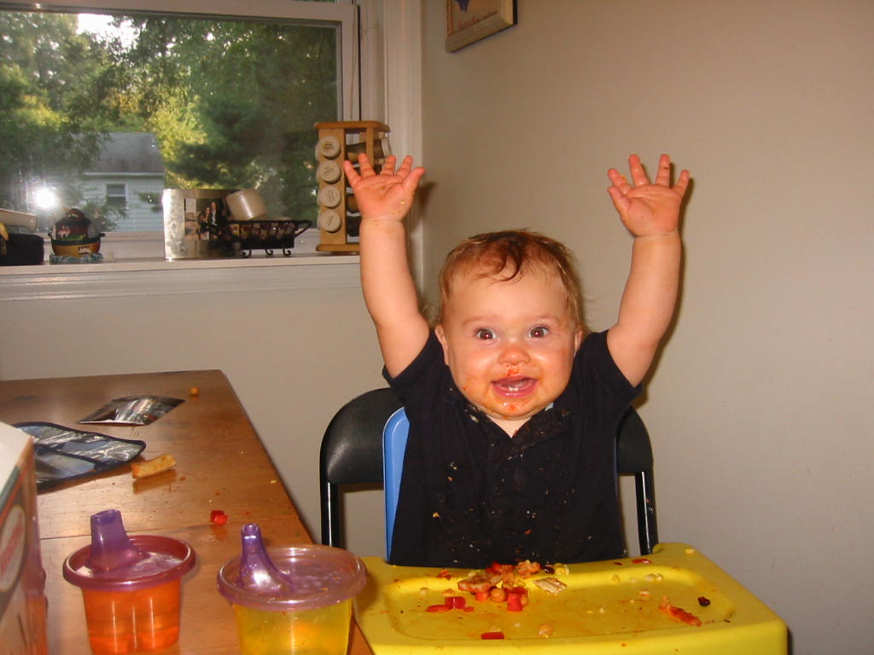

Slide 50
Ready?

Slide 51
Kwame will circle around and call on you!

Slide 52
GO!

Slide 53
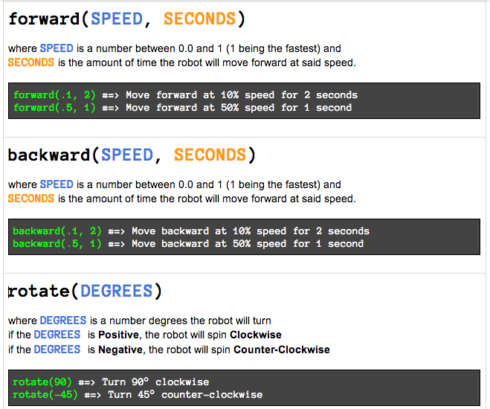

Slide 54
Do This With Your Partner From Before!
Decide who is going to be the robot first and who’s going to be the programmer and then switch!

Slide 55
Now Let’s Try To Do It With The

Slide 56
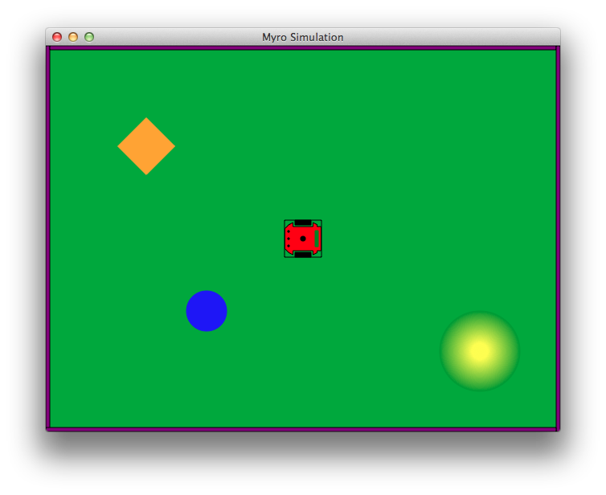
Move the Robot to the Yellow Halo

Slide 57
Demo!

Slide 58
Challenege 1, put your robot on top fo the blue circle.

Slide 59
Challenge 1: Move your robot so it touches the blue circle.

Slide 60
Challenge 1: Move your robot so it touches the blue circle.
If you finish early, try some of the bonus challenges:
Bonus Challenge
Drive the robot in a loop around the blue circle without touching the blue circle.
Bonus Challenge
“Kick” the blue ball so that it hits the orange block before it touches anything of the walls

Slide 61
Bust n Move

Slide 62
Dancing: Loops

Slide 63
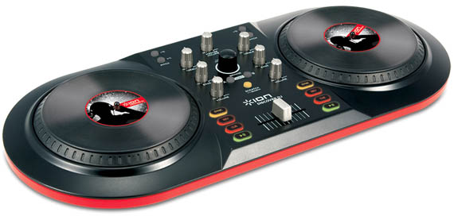

Slide 64
Boots Sin Cats Sin

Slide 65
speak(“Boots Sin Cats Sin”)

Slide 66
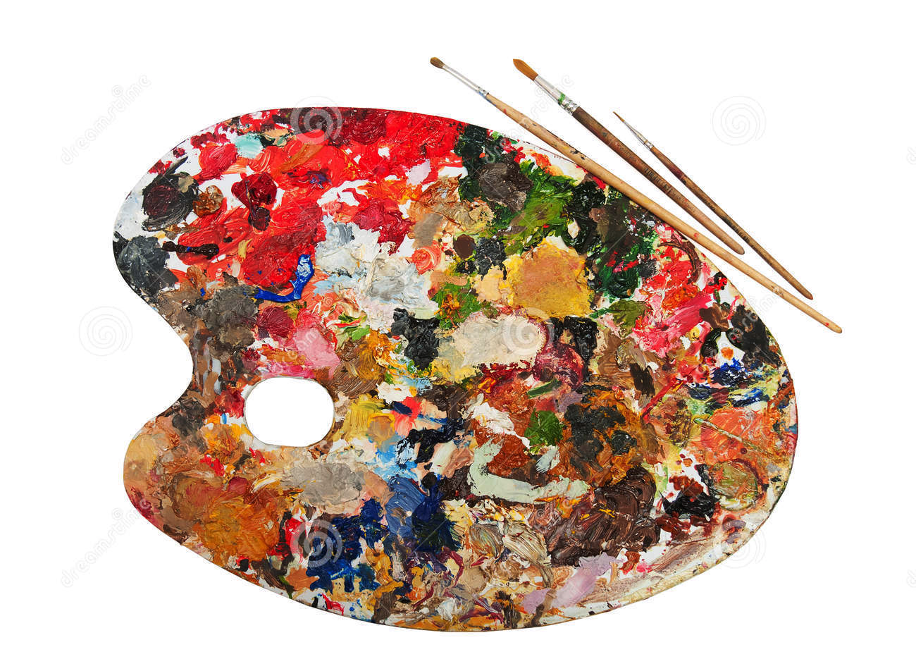
Expressing Yourself

Slide 67
Make Your Own Dity

Slide 69
Make Your Own Dity

Slide 70
speak(“Boots Sin Cats Sin”)
speak(“Boots Sin Cats Sin”)
speak(“Boots Sin Cats Sin”)
speak(“Boots Sin Cats Sin”)

Slide 71
What’s Weird About this?

Slide 72
What should we do instead?

Slide 73
for x in range(4):
speak(“Boots Sin Cats Sin”)

Slide 74
for x in range(4):
speak(“Boots Sin Cats Sin”)
speak(“Yeah Yeah”)

Slide 75
for x in range(4):
speak(“Boots Sin Cats Sin”)
speak(“Yeah Yeah”)

Slide 76
Looping

Slide 77
for x in range(4):
speak(“Boots Sin Cats Sin”)
speak(“Yeah Yeah”)
tinyurl.com/allstarref

Slide 78
Make Your Own Dity With A Loop

Slide 81
Make Your Own Dity With A Loop

Slide 82
Pu Pu Cat Pu Pu Pu Cat

Slide 83
speak(“Pu Pu Cat Pu Pu Pu Cat”)

Slide 84
What if I wanted to switch from looping “boots sin cats” => looping “pu pu cat”?

Slide 85
for x in range(4):
speak(“Boots Sin Cats Sin”)
speak(“Yeah Yeah”)
for x in range(4):
speak(“Pu pu cat pu…”)
for x in range(4):
speak(“Boots Sin Cats Sin”)
speak(“Yeah Yeah”)
for x in range(4):
speak(“Pu pu cat pu…”)

Slide 87
Make your own dities with functions!

Slide 88
tinyurl.com/allstarref

Slide 89

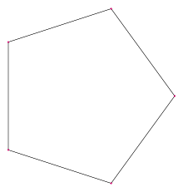


Slide 91
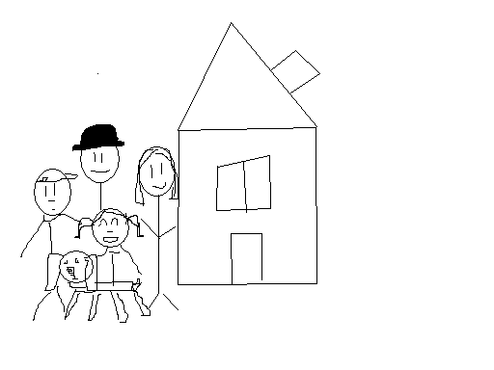

Slide 92
Workflow

Slide 93
Drawing Your Team Name

Slide 95
Draw Whatever You Want!

